Slide 1
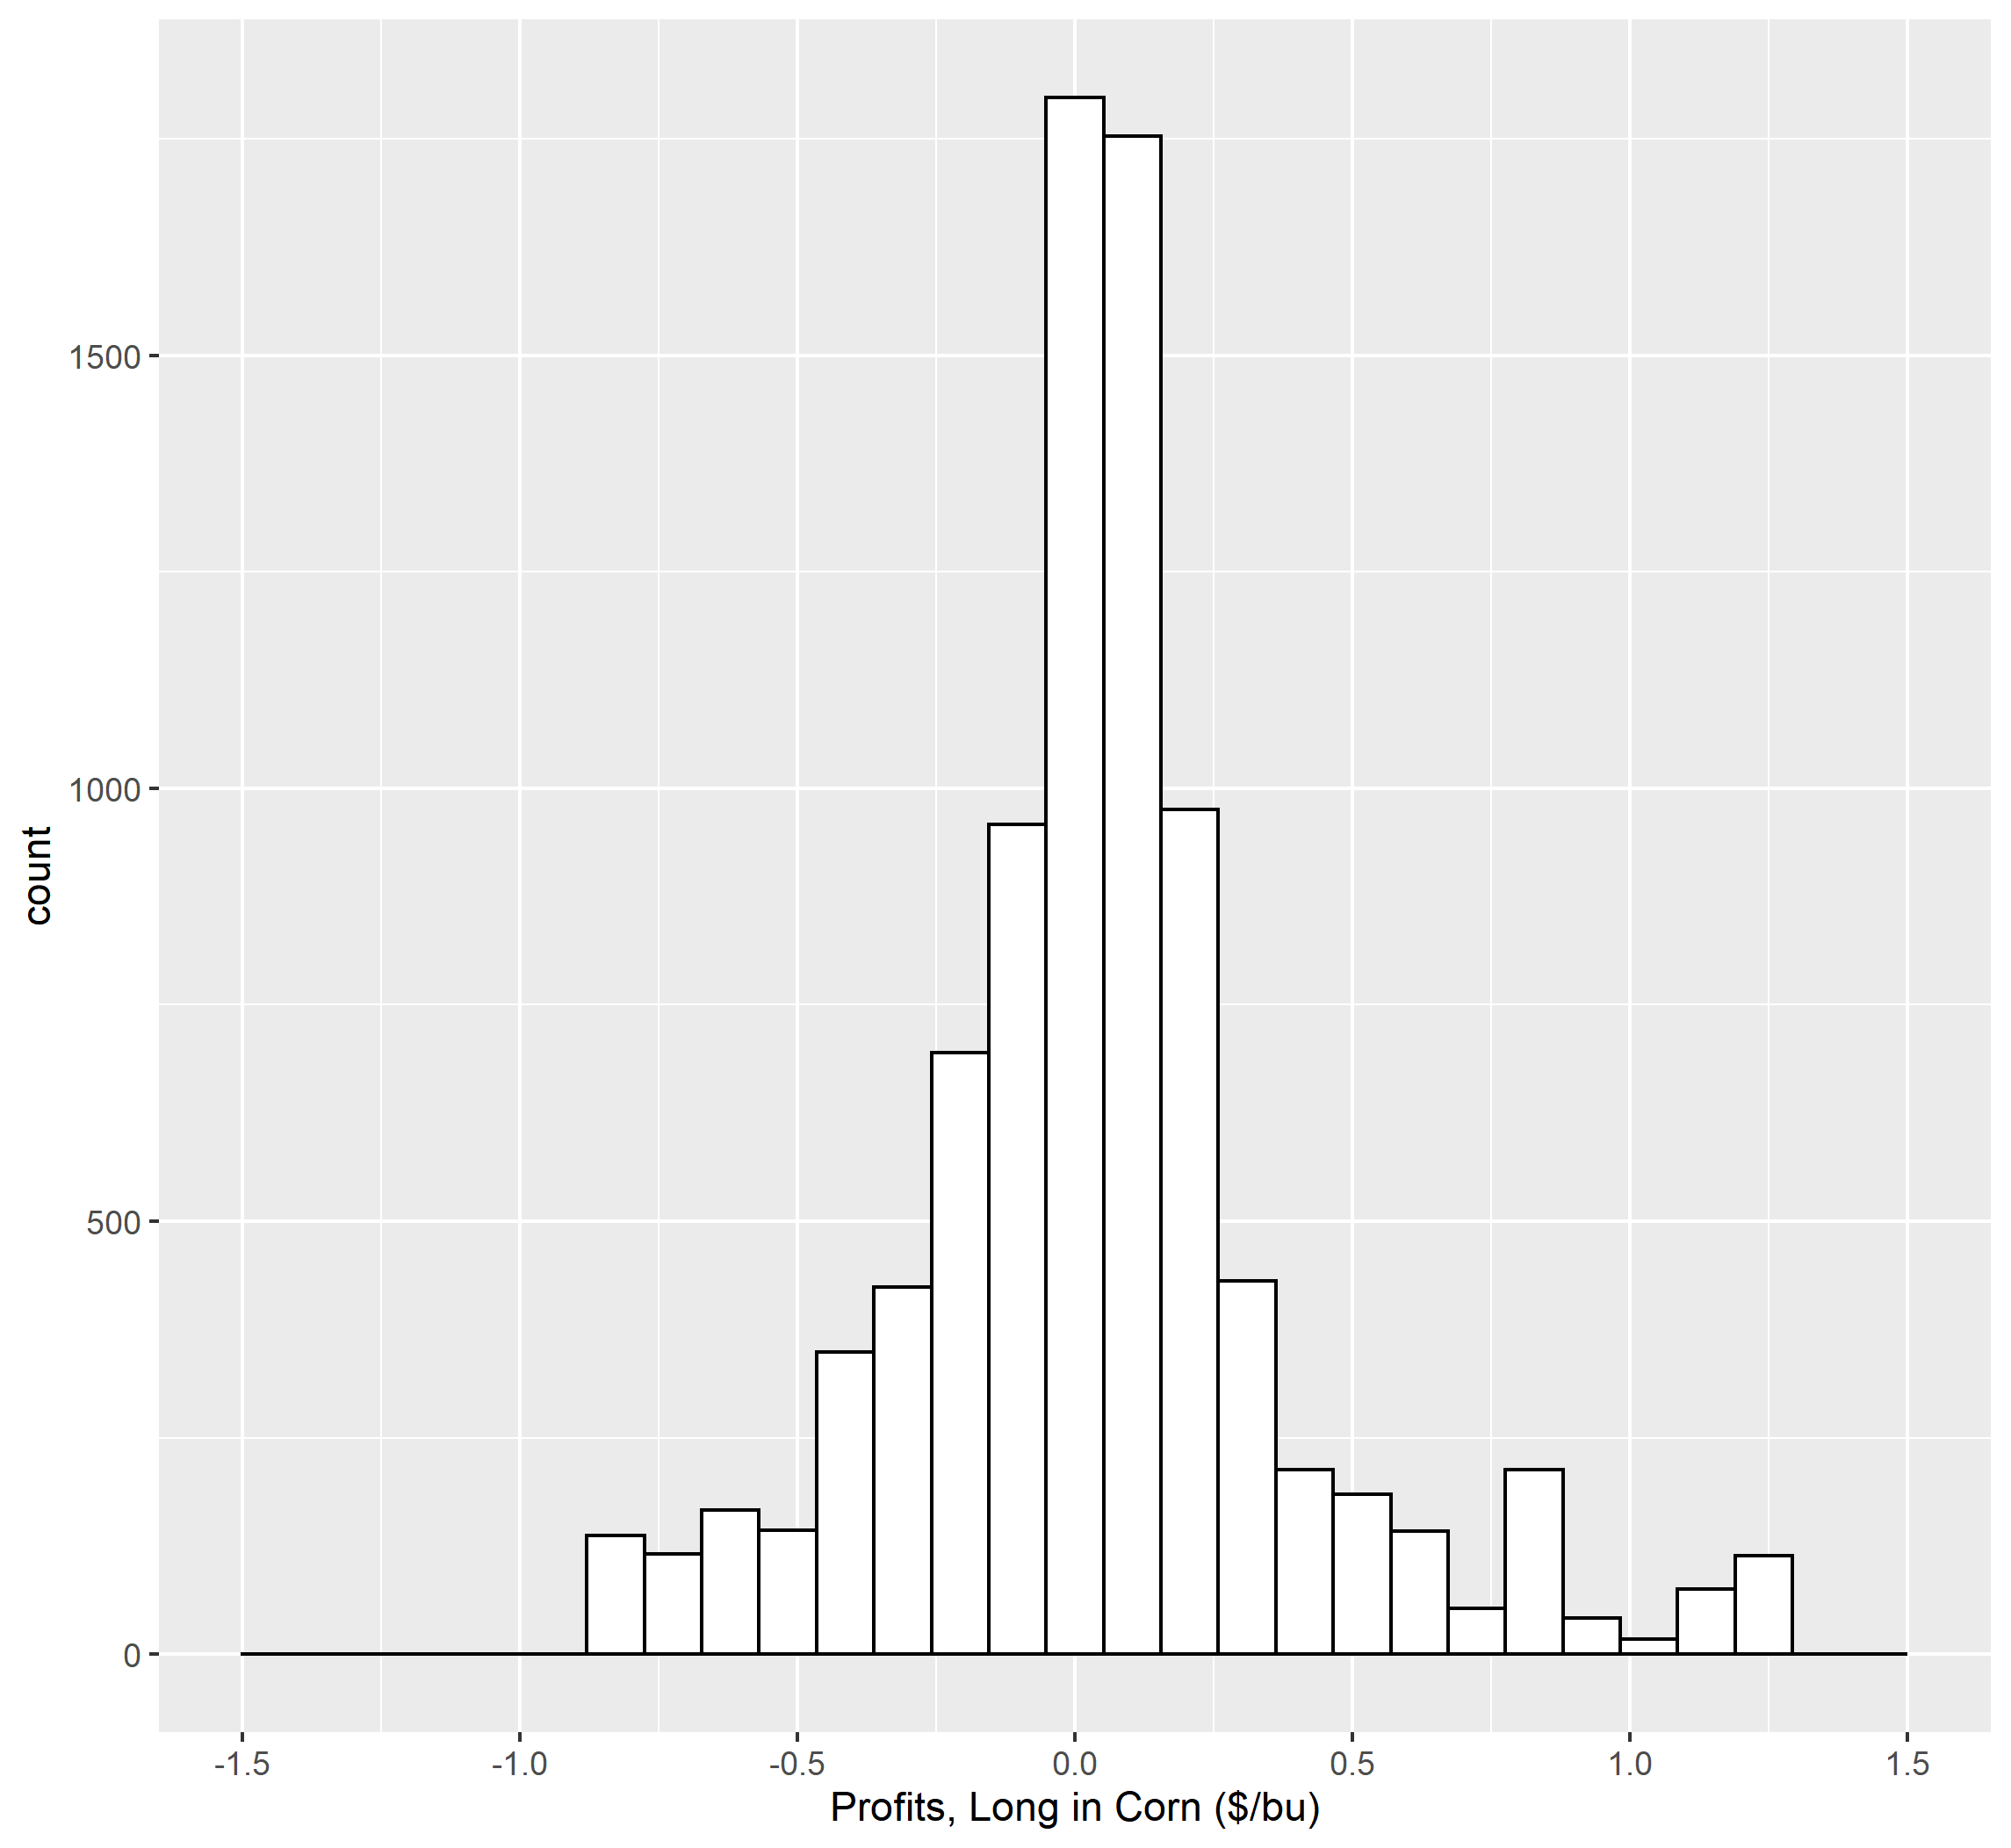
Great!

Slide 2
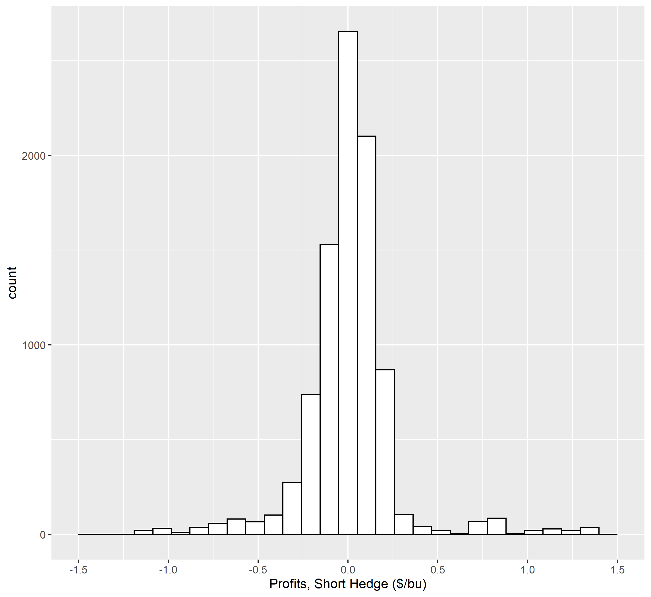
Great!

Slide 3
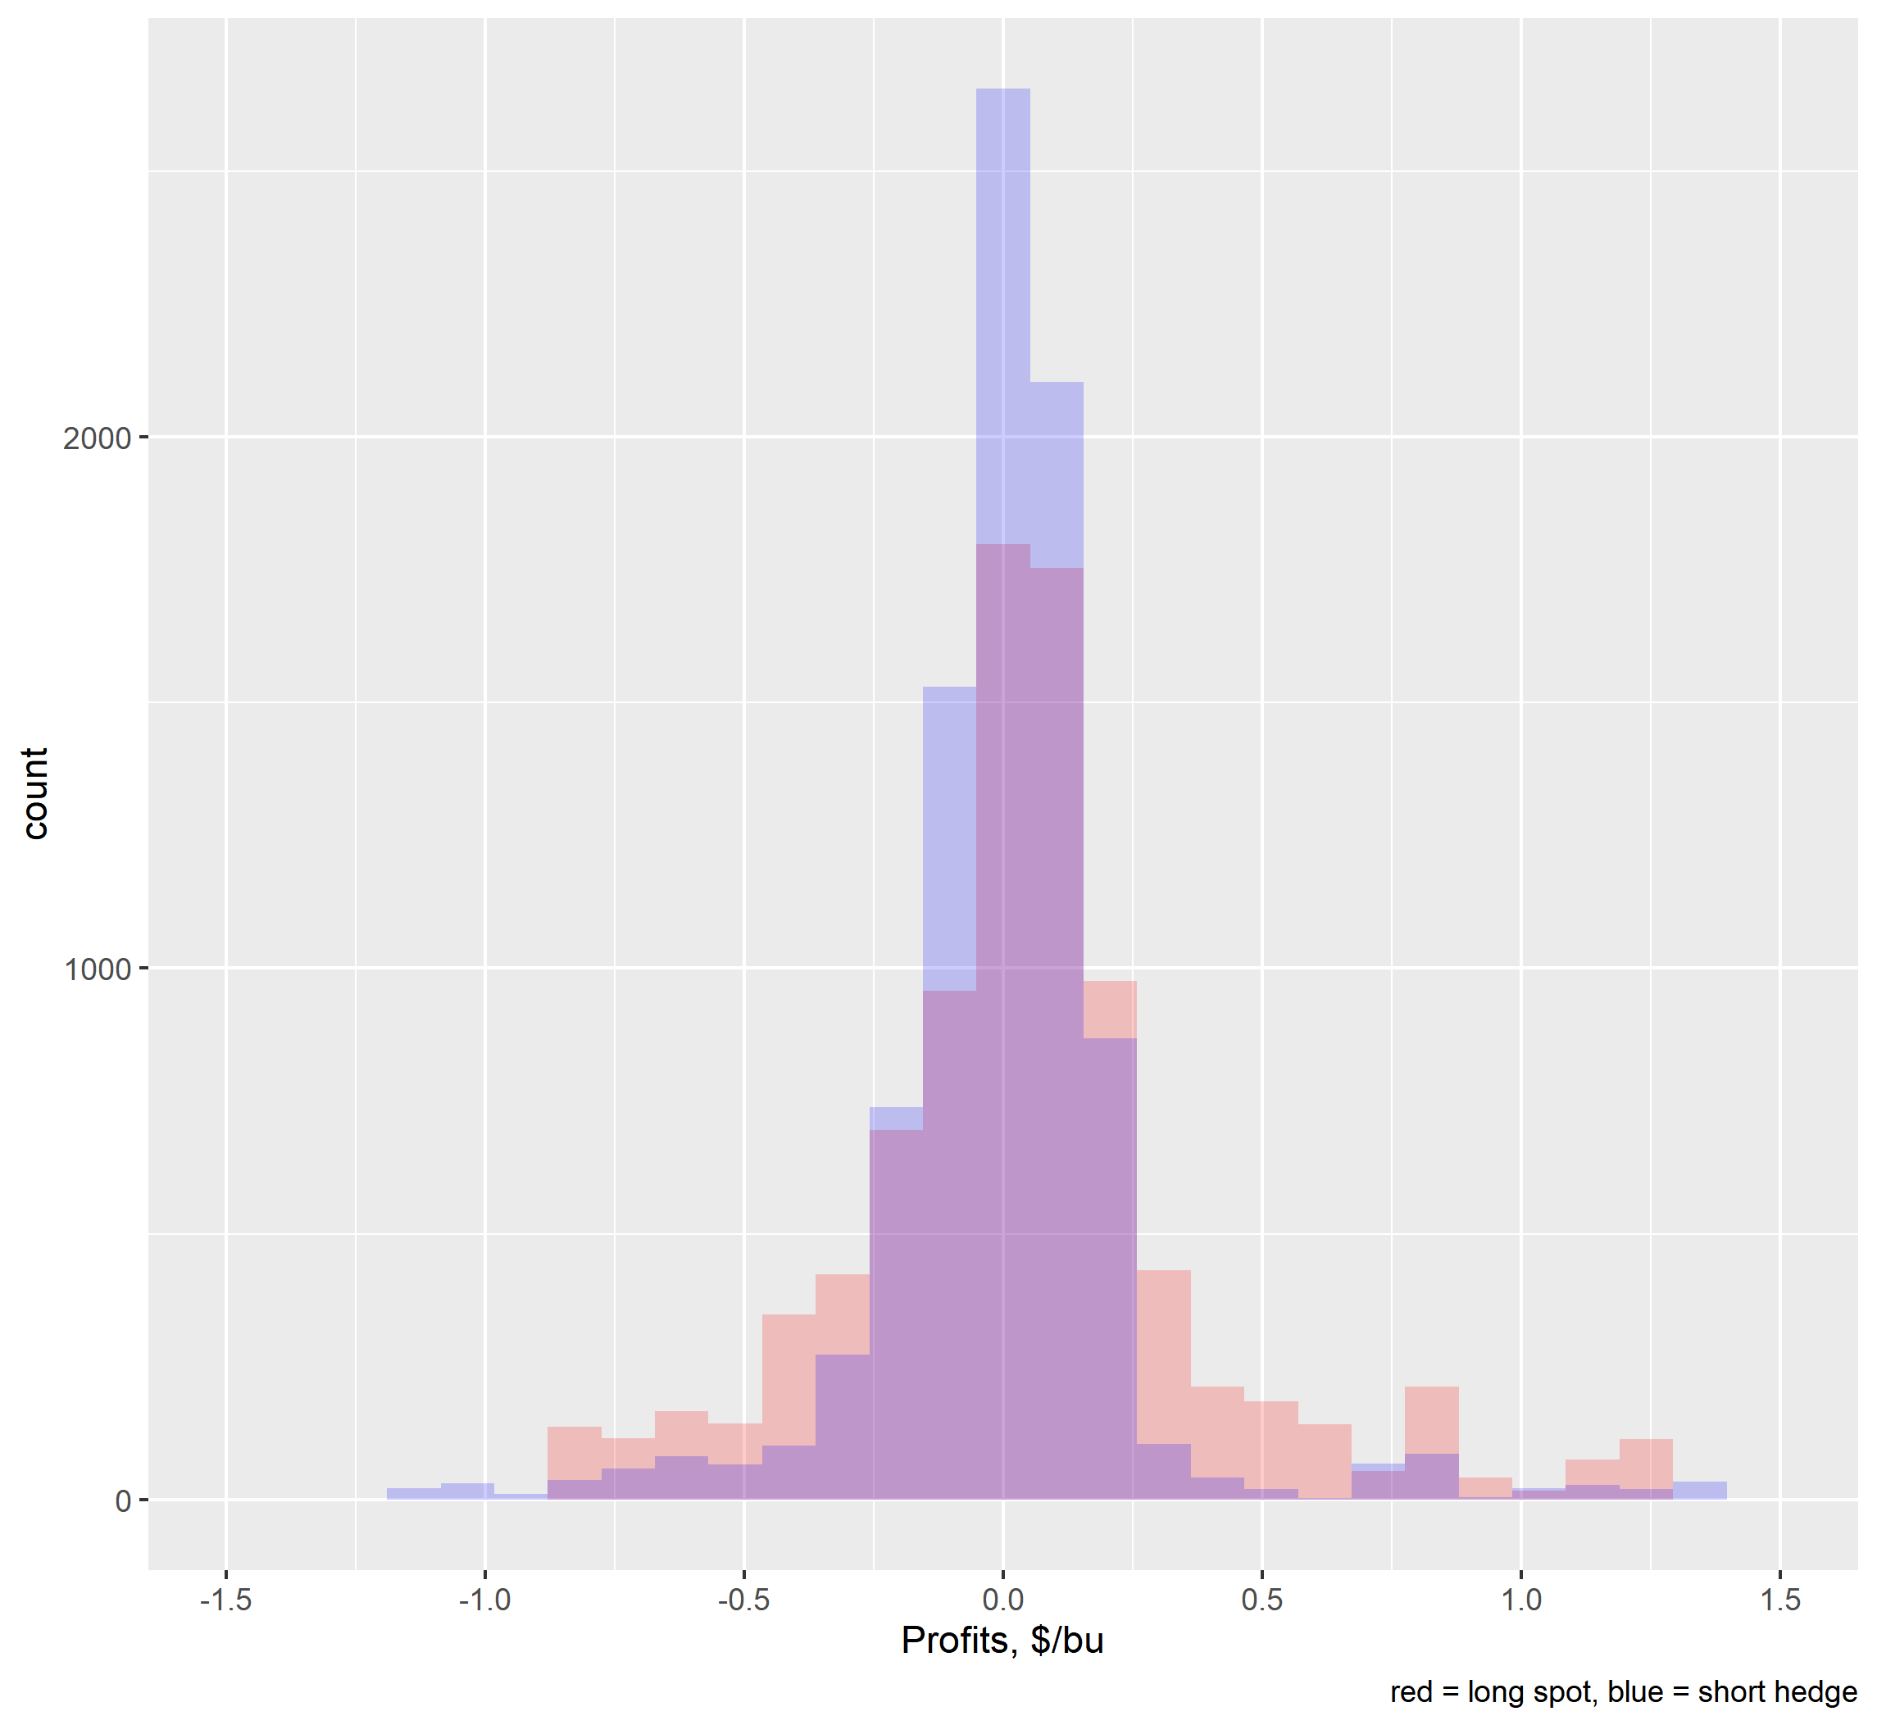
Great!

Slide 4
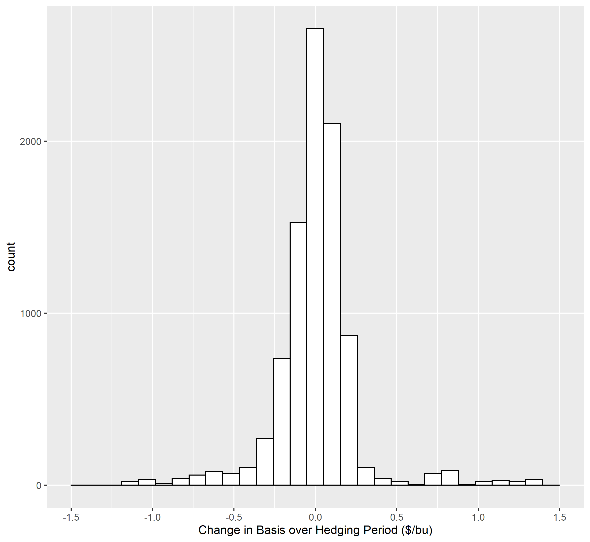
Great!

Slide 5

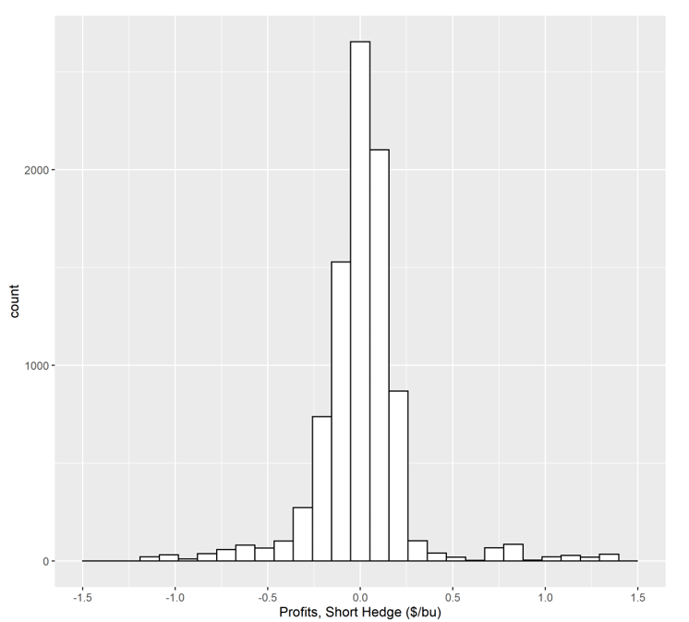
The histogram for the Change in Basis over Hedging Period and Profits, Short Hedge are identical because the change in the basis is an exact measure of the profits for the short hedger.

Slide 6
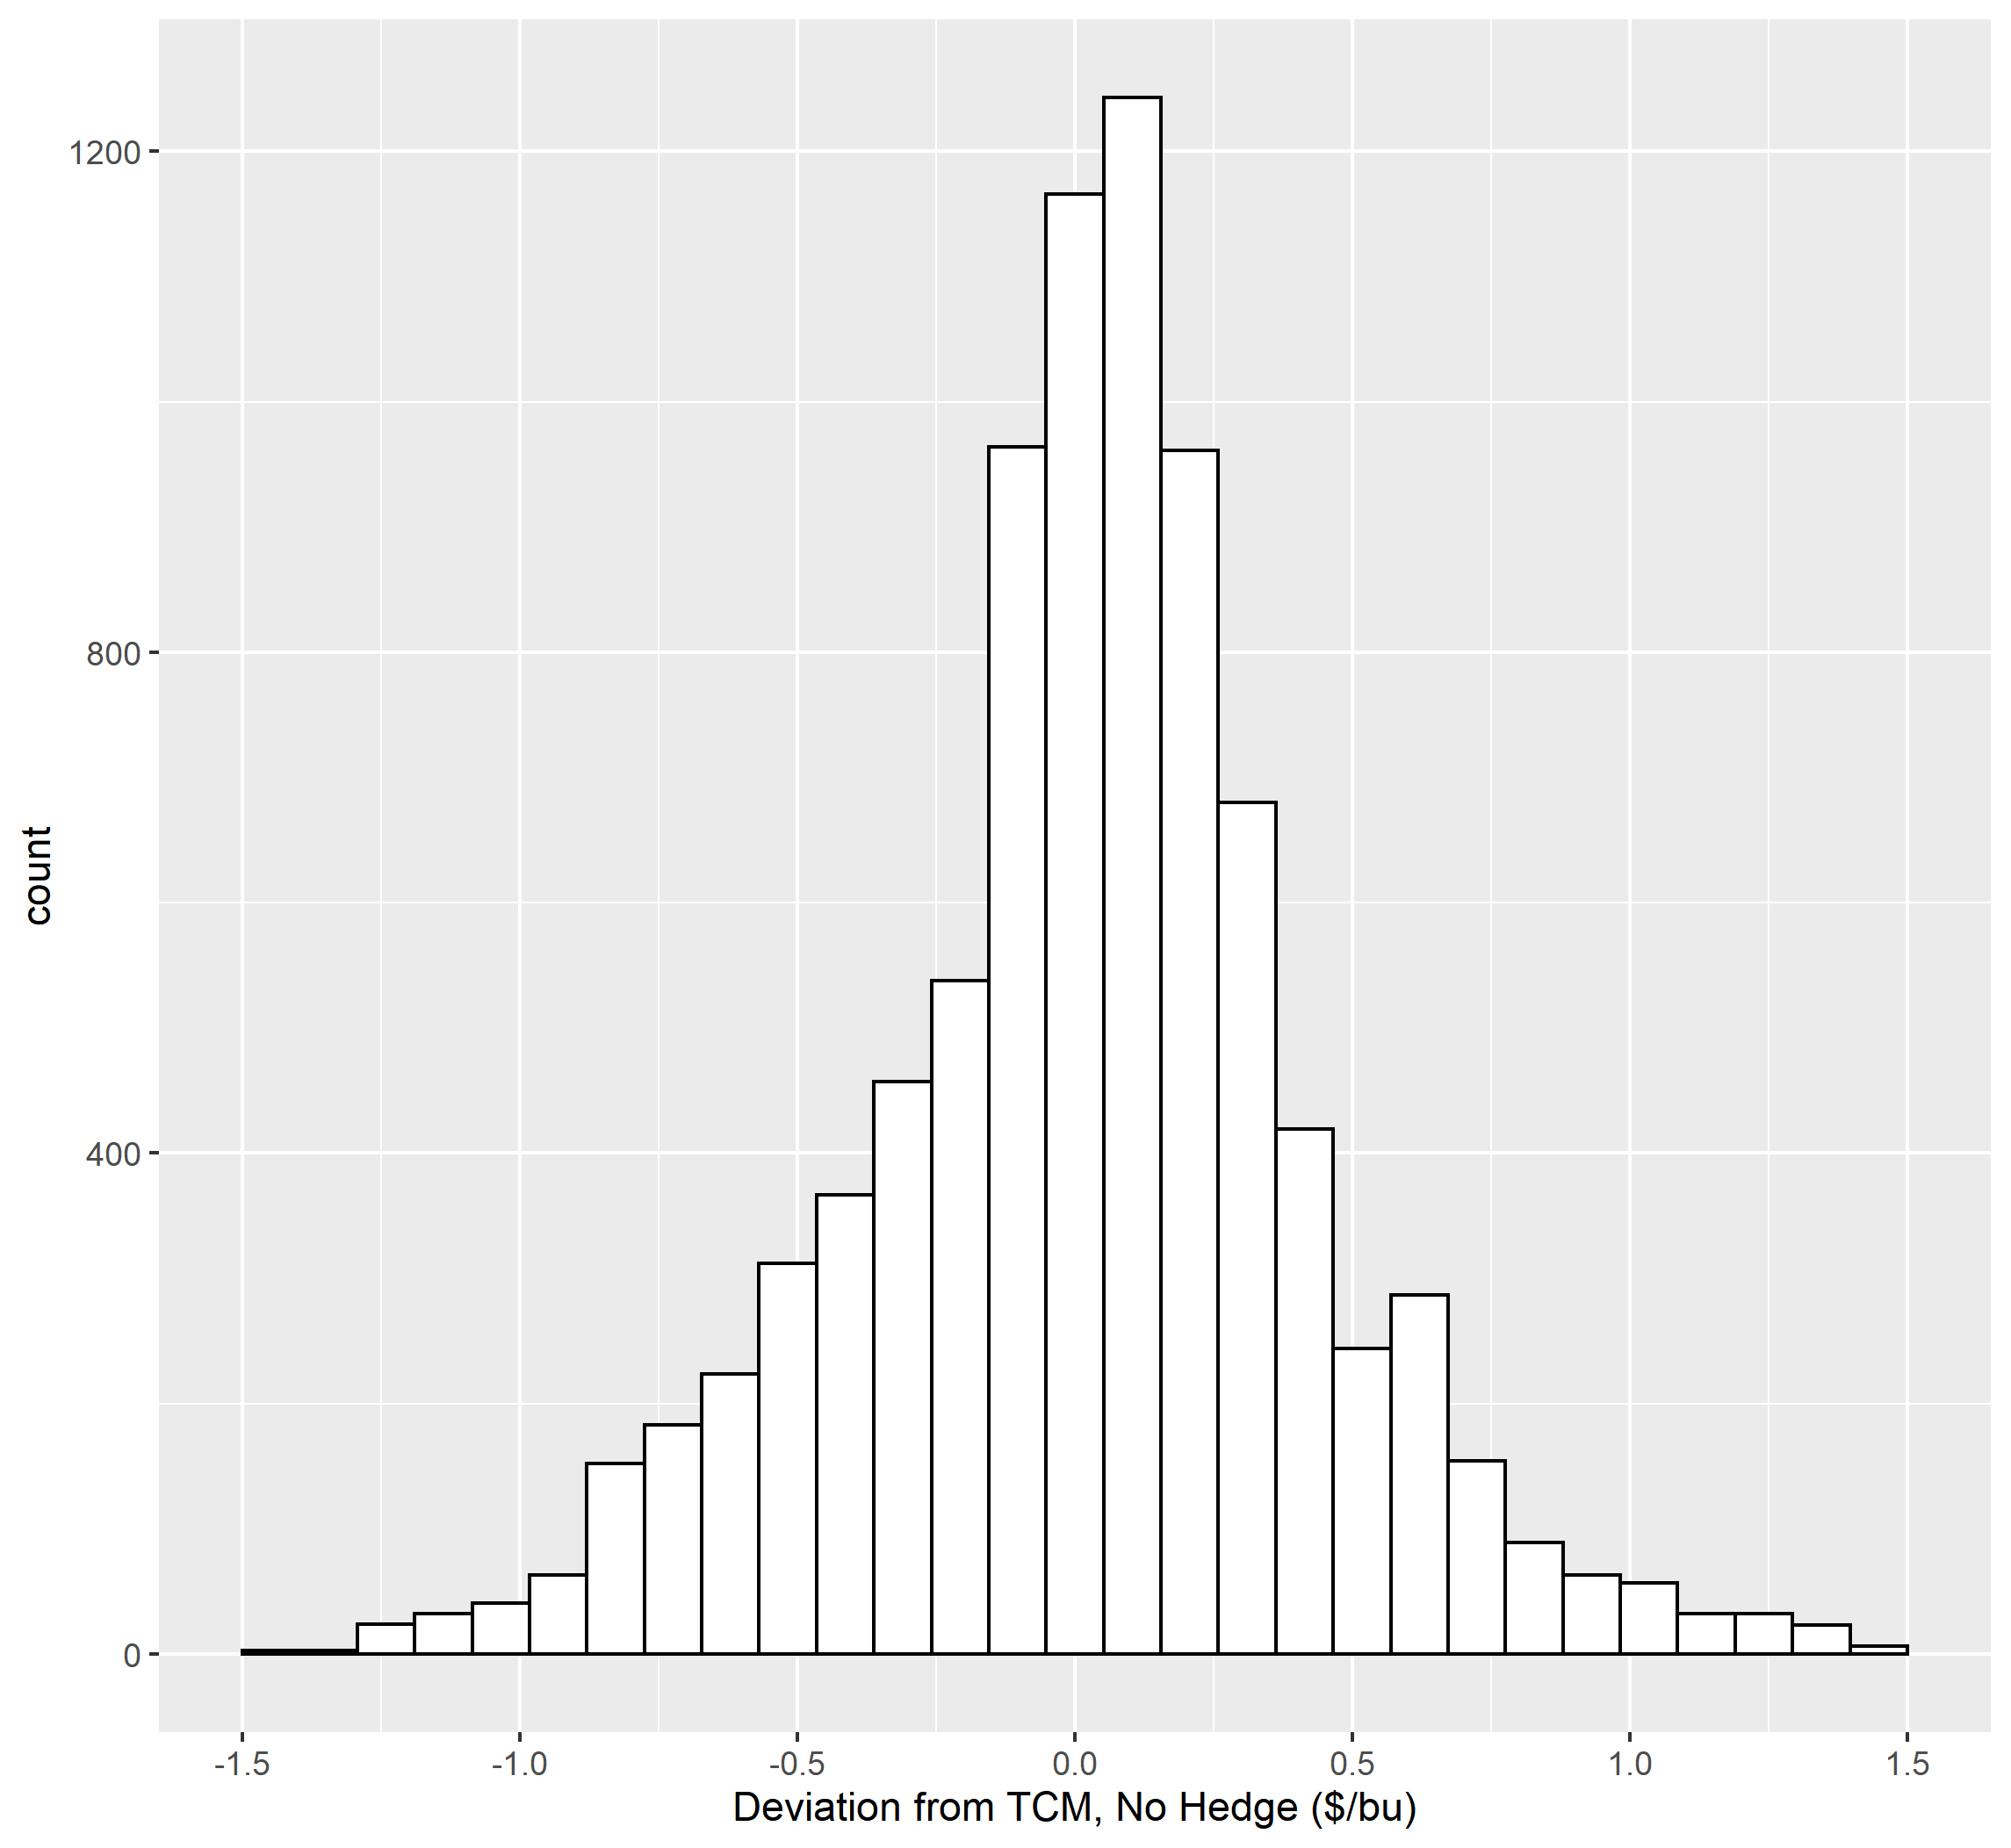
Note: “TCM” stands for “Target Crush Margin”

Slide 7
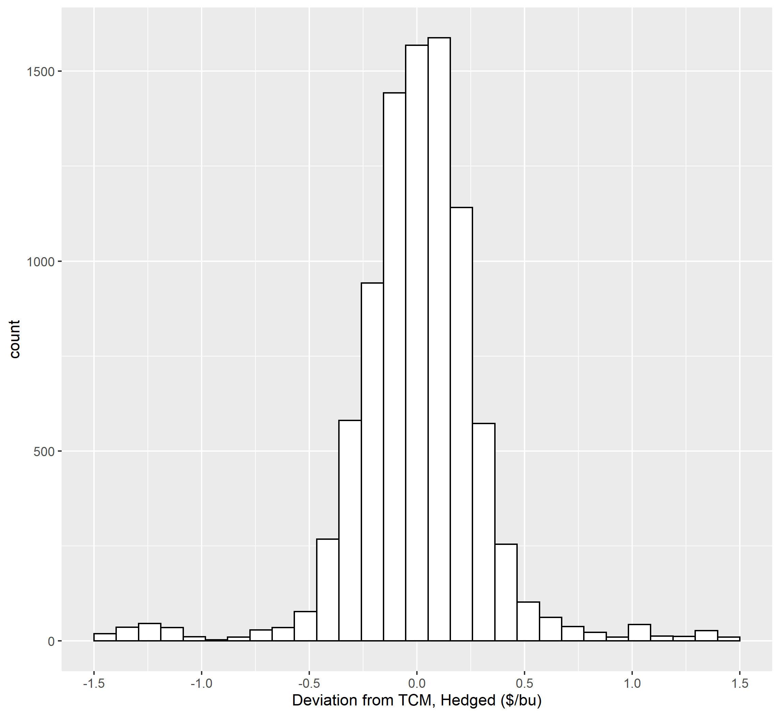
Great!

Slide 8
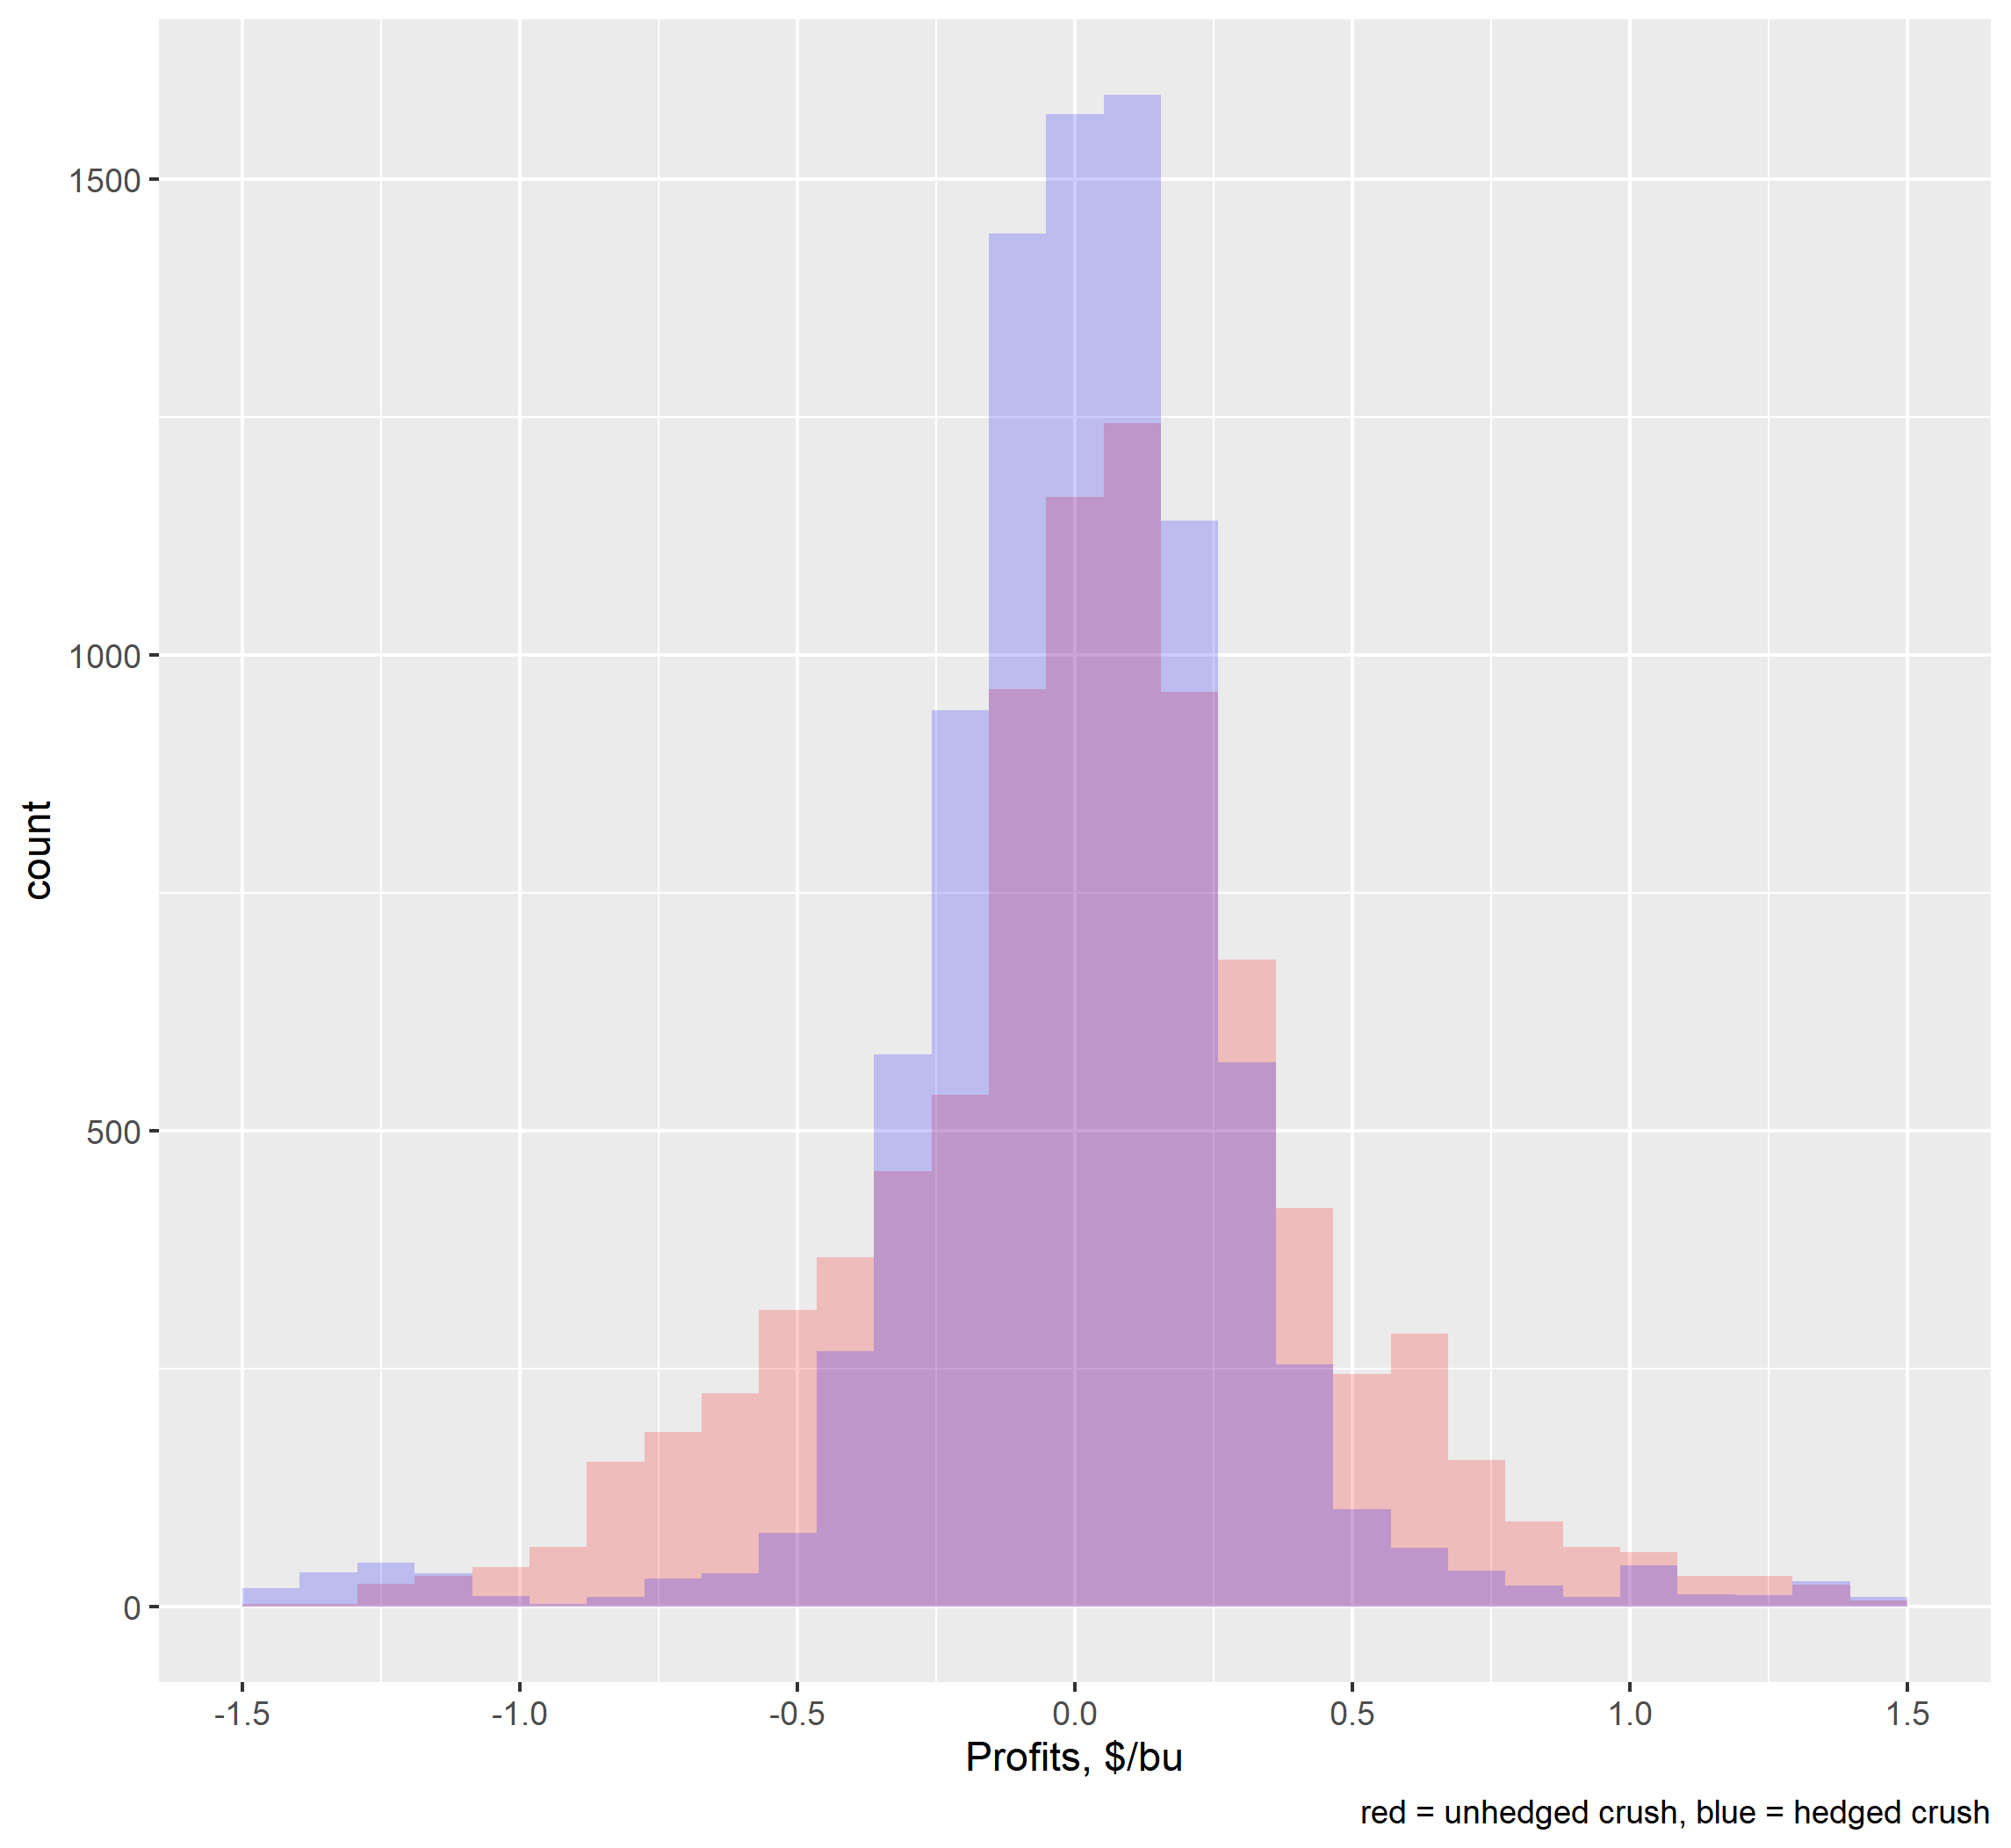
Great!

